Slide 1
TRAFFIC LIGHT SYSTEM
Working with the Arduino microcontroller
Submitted By
Taimour Ali

Slide 2
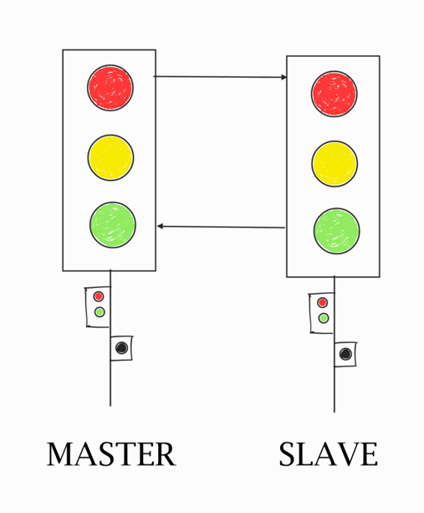
Project Idea: TRAFFIC LIGHT CONTROL SYSTEM
I2C
COMMUNICATION

Slide 3
TASK 05
The interface can be represented by an appropriate event (e.g. signalizing switching to a specific state (e.g. redStateEvent) of (two) different state machines
 Run the TLS in parallel (You have different possibilities)
 Via different Arduino instances that connected via an appropriate serial interface (UART, I2C, …)
 Extra: Via a network connection (TCP/UDP) via a standard C/C++ implementation

Slide 4
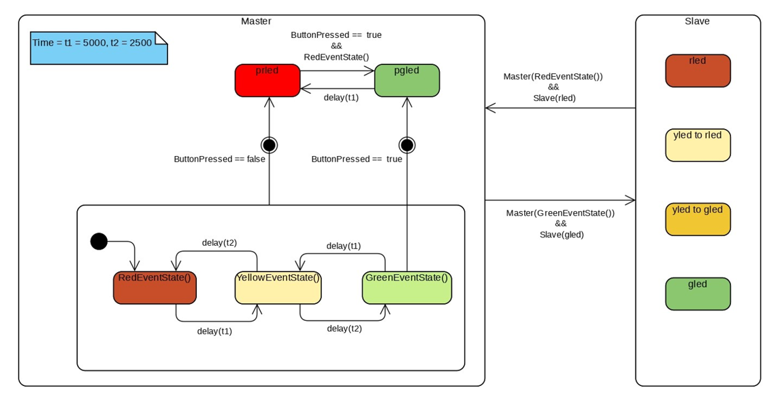
STATE MACHINE DIAGRAM

Slide 5
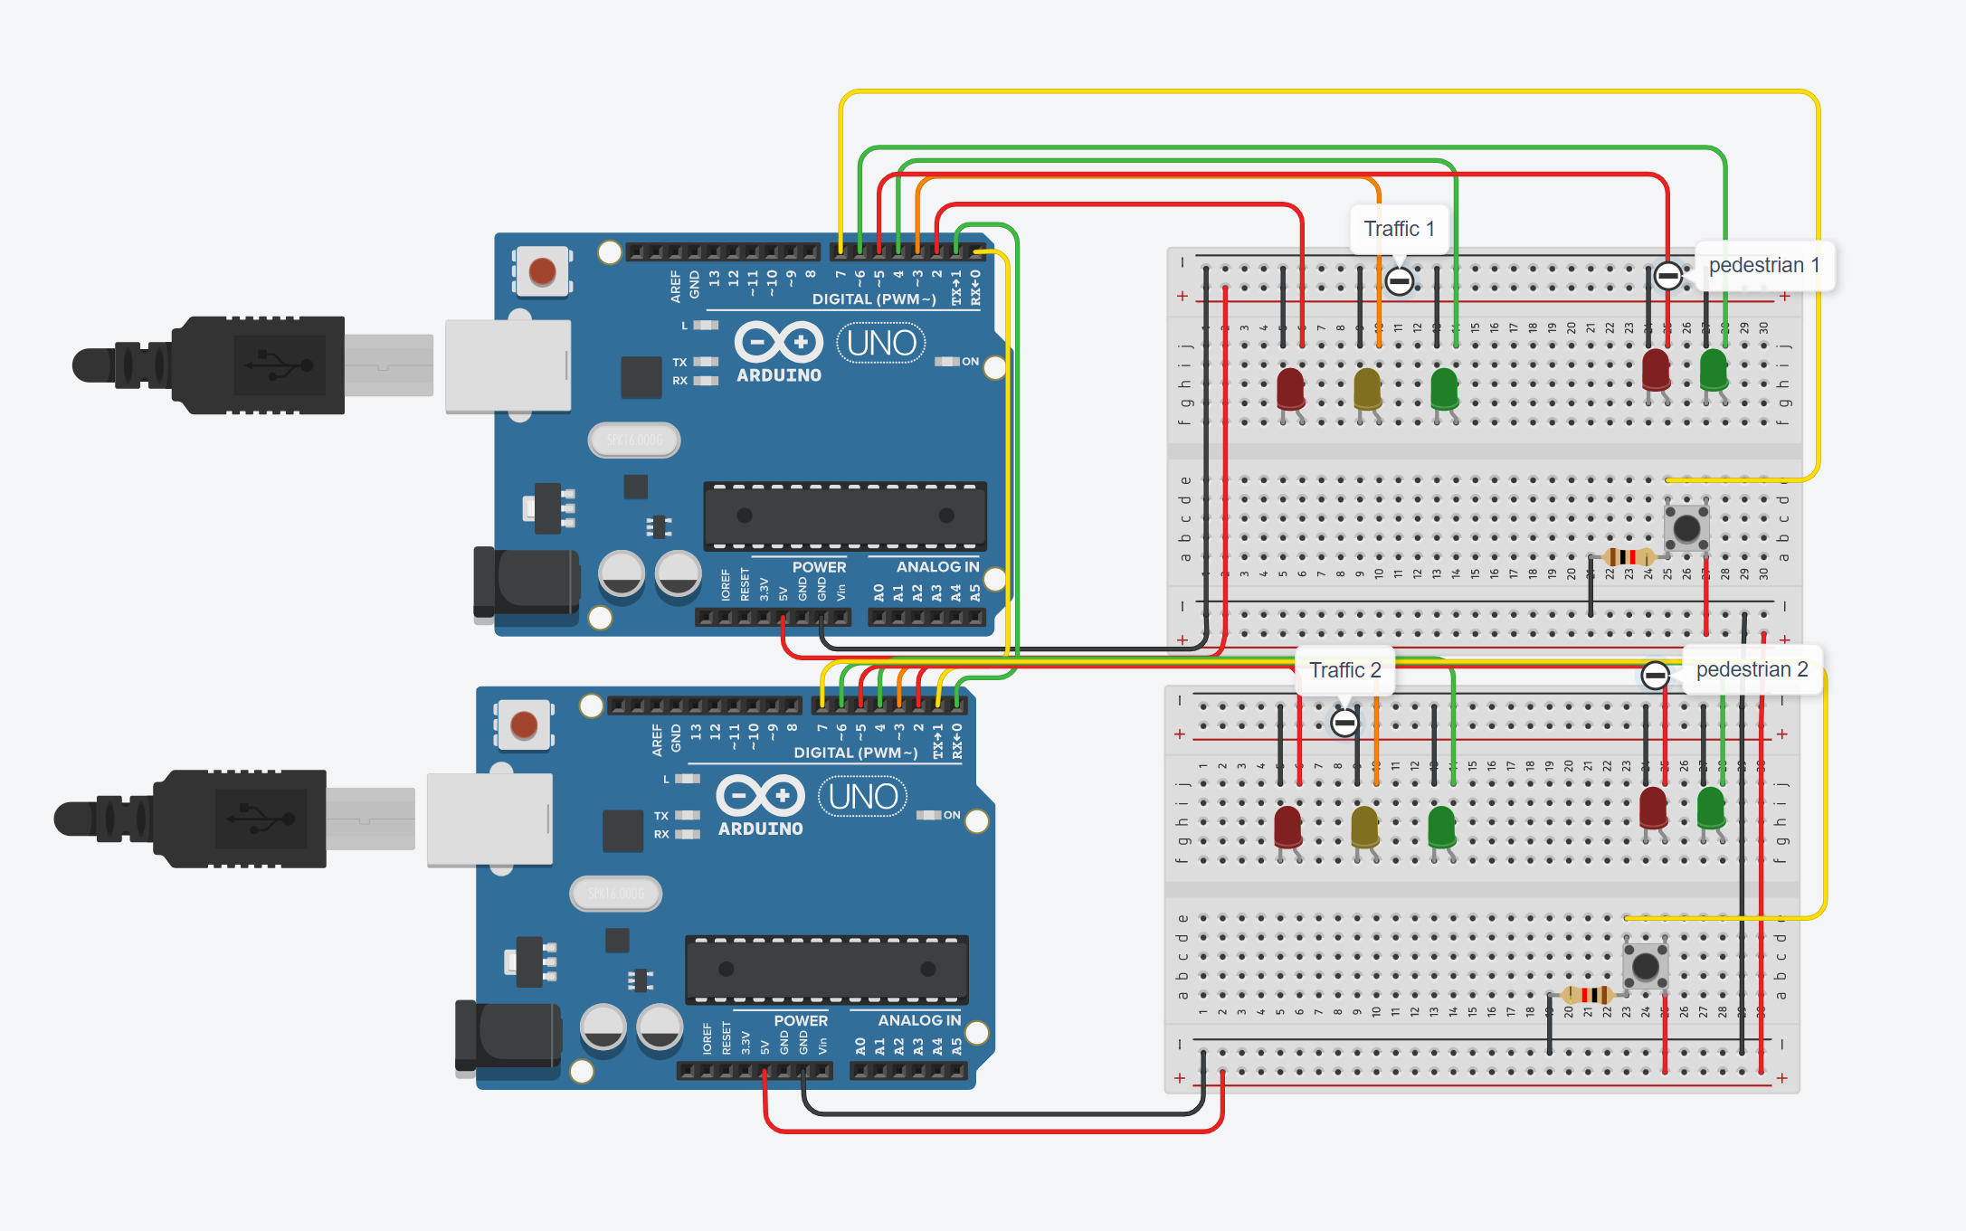
TRAFFIC LIGHT SYSTEM - ARDUINO IMPLEMENTATION

Slide 6
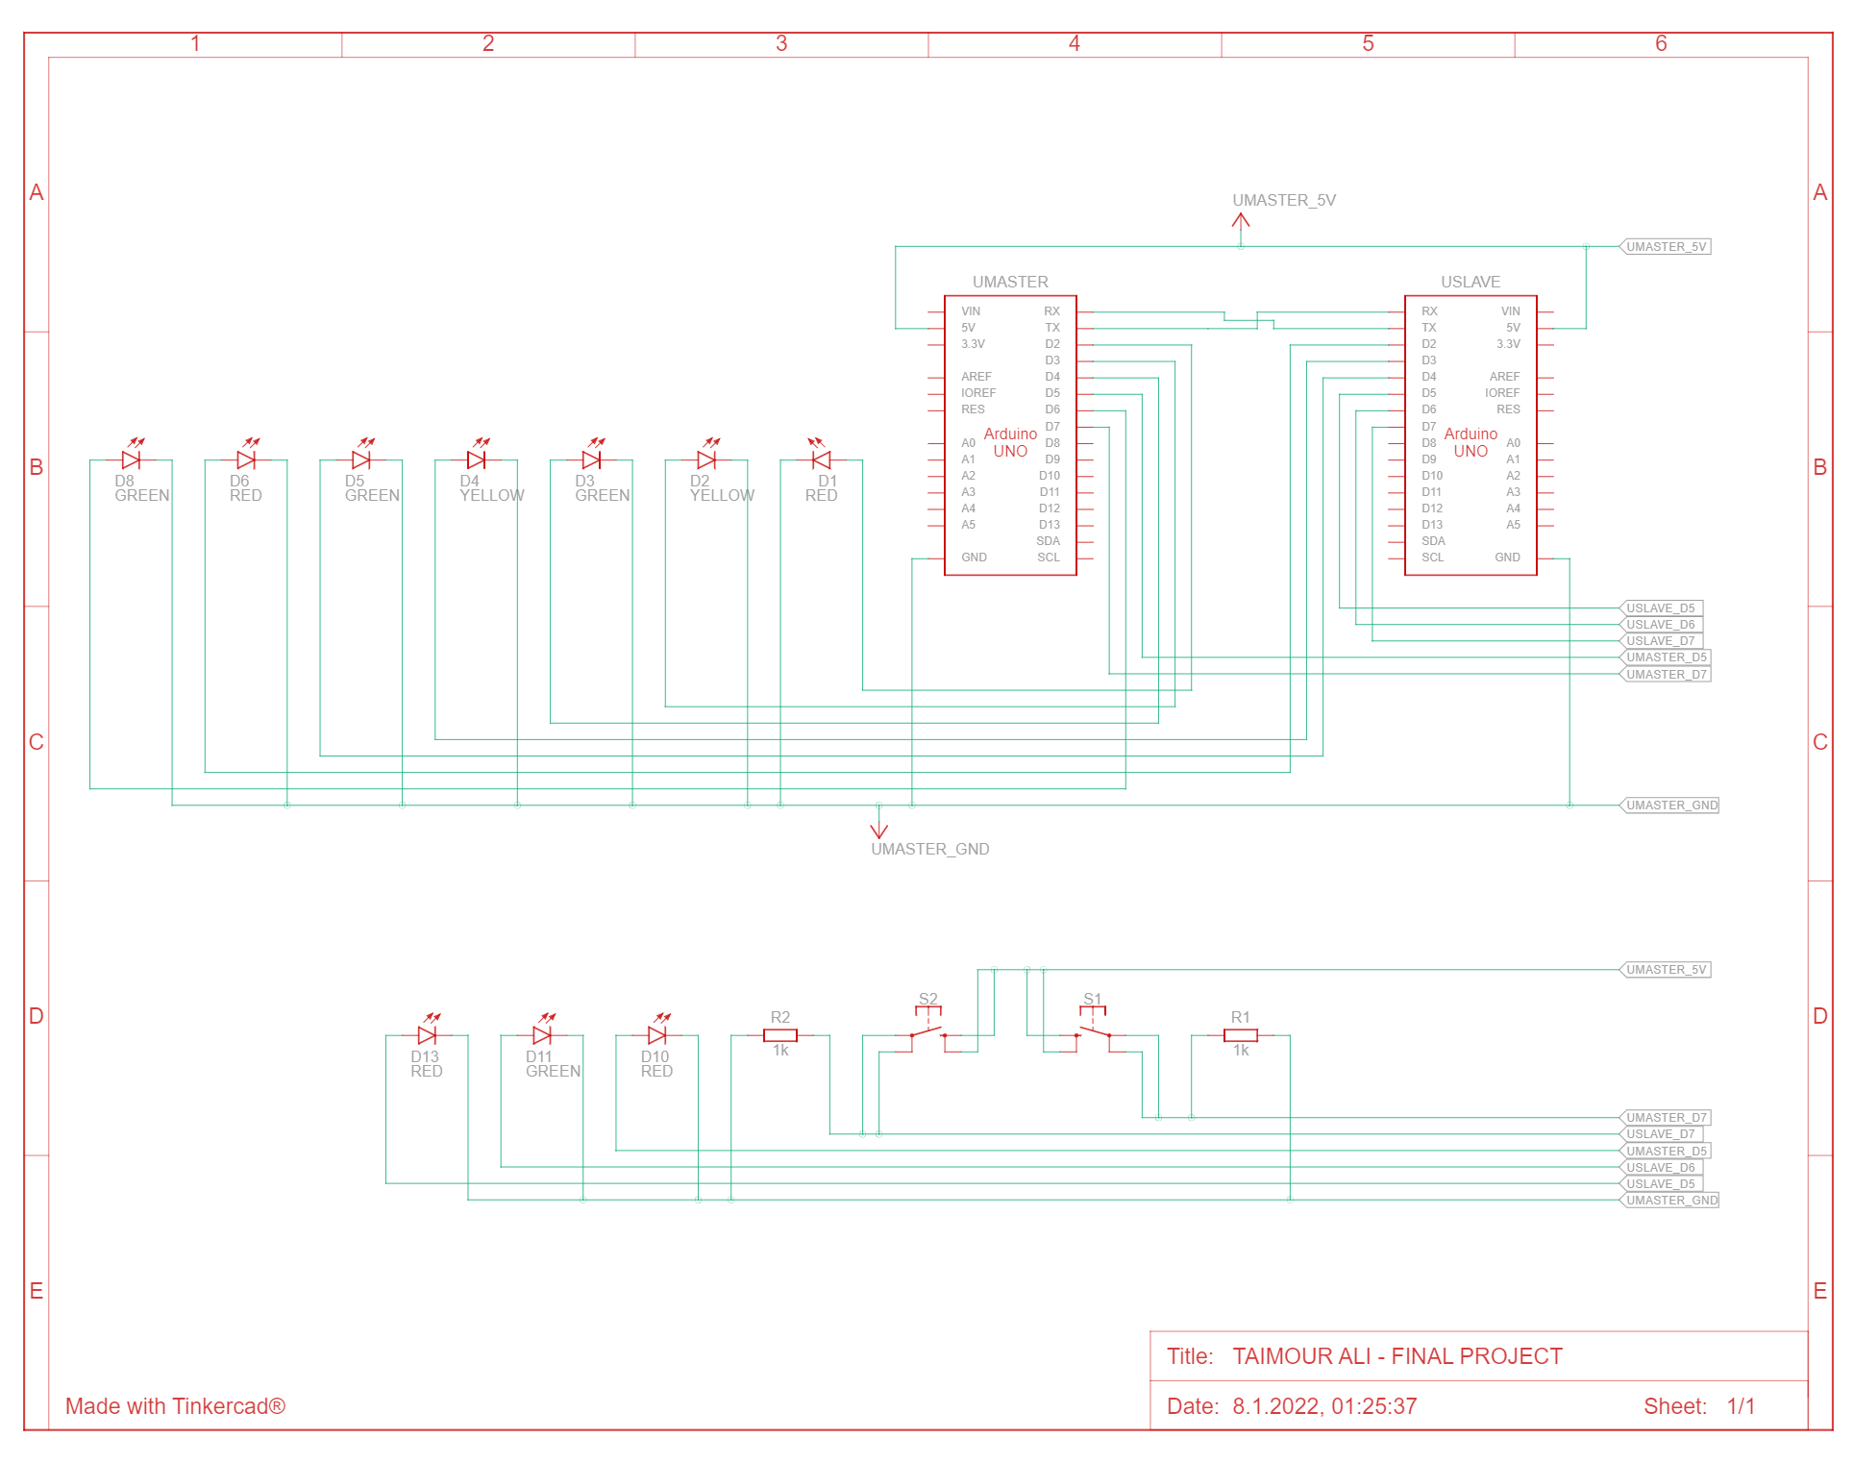
TRAFFIC LIGHT SYSTEM - SCHEMATIC VIEW

Slide 7
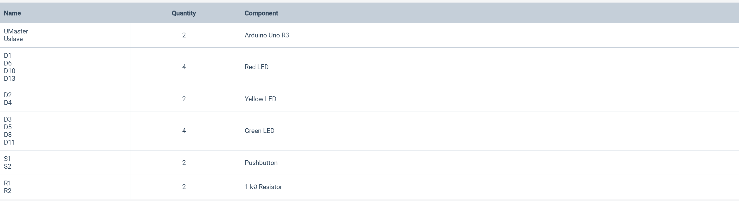
TRAFFIC LIGHT SYSTEM - COMPONENT LIST

Slide 8
DECLARING VARIABLES FOR MASTER
//MASTER
#define rled 2 //Red LED
#define yled 3 //Yellow LED
#define gled 4 //Green LED
#define button 7 //Push button
#define prled 5 //Red pedestrian light
#define pgled 6 //Green pedestrian light
int t1=5000,t2=2500; //T1=Green,Red, and T2=Yellow
int bstate=0; //If button is not pressed
//1 = green, 2= yellow, 3= red

Slide 9
SETTING PINS TO OUTPUT
void setup()
{
Serial.begin(9600); //Call serial communication
pinMode(rled, OUTPUT);
pinMode(yled, OUTPUT);
pinMode(gled, OUTPUT);
pinMode(prled, OUTPUT);
pinMode(pgled, OUTPUT);
pinMode(button, INPUT);
digitalWrite(prled,1);
digitalWrite(pgled,0);

Slide 10
FUNCTION FOR BUTTON PRESSED
void loop() //Function for button pressed
{
bstat();
syn();
}
void bstat() //If the button is not pressed
{
bstate=digitalRead(button);
if(bstate==1) // If the button is pressed
{
psyn(); //For synchoronization we make this function
}
}

Slide 11
FUNCTION FOR SYNCHORONIZATION
void psyn() //If the button is pressed whatever the state of the traffic light will be, it will go directly to yellow
{
YellowEventState();//Jump to yellow
delay(t2);
RedEventState();//Jump to red
digitalWrite(prled,0);// Red will be 0
digitalWrite(pgled,1);//Green will be 1
delay(t1);
digitalWrite(prled,1);
digitalWrite(pgled,0);
YellowEventState();
delay(t2);
}

Slide 12
FUNCTION FOR SYNCHORONIZATION
void syn()
{
GreenEventState();//Jump to green
Serial.write(3);//3=red
delay(t1);
bstat();
YellowEventState();//Jump to yellow
Serial.write(2);//2=yellow
delay(t2);
bstat();
RedEventState();//Jump to red
Serial.write(1);
delay(t1);
bstat();
YellowEventState();//Jump to yellow
Serial.write(2);
delay(t2);
bstat();
}

Slide 13
DECLARATION OF EVENTS
void RedEventState() //Function for RedEventState
{
digitalWrite(rled,1); //Red will turn on
digitalWrite(yled,0);
digitalWrite(gled,0);
}
void YellowEventState() //Function for YellowEventState
{
digitalWrite(rled,0);
digitalWrite(yled,1); //Yellow will turn on
digitalWrite(gled,0);
}
void GreenEventState() //Function for GreenEventState
{
digitalWrite(rled,0);
digitalWrite(yled,0);
digitalWrite(gled,1); //Green will turn on
}

Slide 14
DECLARING VARIABLES FOR SLAVE
//SLAVE
#define rled 2
#define yled 3
#define gled 4
#define button 7
#define prled 5
#define pgled 6
int incomingByte=0;
int bstate=0;
int t1=5000,t2=2500; //T1=Green,Red, and T2=Yellow

Slide 15
SETTING PINS TO OUTPUT
void setup()
{
Serial.begin(9600);//Call serial communication
pinMode(rled, OUTPUT);
pinMode(yled, OUTPUT);
pinMode(gled, OUTPUT);
pinMode(prled, OUTPUT);
pinMode(pgled, OUTPUT);
pinMode(button, INPUT);
digitalWrite(prled,1);
digitalWrite(pgled,0);
}

Slide 16
FUNCTION FOR CHECKING THE STATE
void loop()
{
checkstate();//Function for checking the state --- Line 67 to 73, I made a separation function to check the state
bstat();
if(incomingByte==1) //If incomingByte is 1, we will call green
{
GreenEventState();
}
else if(incomingByte==2)//If incomingByte is 1, we will call yellow
{
YellowEventState();
}
else if(incomingByte==3)//If incomingByte is 1, we will call red
{
RedEventState();
}
else //Otherwise all states will be zero
{
digitalWrite(rled,0);
digitalWrite(yled,0);
digitalWrite(gled,0);
}
bstat();
}

Slide 17
FUNCTION FOR BUTTON STATE
void bstat()
{
bstate=digitalRead(button);
if(bstate==1)//If the button is pressed
{
YellowEventState();//Jump to Yellow State
delay(t2);
RedEventState();//Jump to Red State
digitalWrite(prled,0);
digitalWrite(pgled,1);
delay(t1);
digitalWrite(prled,1);
digitalWrite(pgled,0);
YellowEventState();
delay(t2);
}
}

Slide 18
FUNCTION FOR CHECKING THE STATE
void checkstate() //Checking the state of a function
{
if (Serial.available() > 0) { //If Serial.available is greater than zero in the serial
incomingByte = Serial.read();//It will read as Serial.read and save in IncomingByte
Serial.print("Received State: ");//and it will print the Received State
Serial.println(incomingByte, DEC);
}
}

Slide 19
DECLARATION OF EVENTS
void RedEventState()//Function for RedEventState
{
digitalWrite(rled,1);
digitalWrite(yled,0);
digitalWrite(gled,0);
}
void YellowEventState()//Function for YellowEventState
{
digitalWrite(rled,0);
digitalWrite(yled,1);
digitalWrite(gled,0);
}
void GreenEventState()//Function for GreenEventState
{
digitalWrite(rled,0);
digitalWrite(yled,0);
digitalWrite(gled,1);
}

Slide 20
THANK YOU
Have a wonderful day ahead 🙂

